Slide 1
Wireless Body Area Network for Health Monitoring
Emil Jovanov, Chris Ott, Aleksandar Milenkovic
Electrical and Computer Engineering
The University of Alabama in Huntsville
email: jovanov@ece.uah.edu
Web: http://www.ece.uah.edu/~jovanov

Slide 2
WBAN: Motivation
Goal: ubiquitous and affordable healthcare
Conditions: demographic and technology trends
Solution: 3-tier ubiquitous monitoring system
  Tier 1: Wireless Body Area Network (WBAN)
  Tier 2: Personal Server
  Tier 3: Healthcare Provider Servers
Opportunities:
  Ambulatory health monitoring
  Computer-assisted rehabilitation
  Augmented reality systems
Long-term benefits:
  Promote healthy lifestyle
  Seamless integration of data into personal medical records and research databases
  Knowledge discovery through data mining

Slide 3
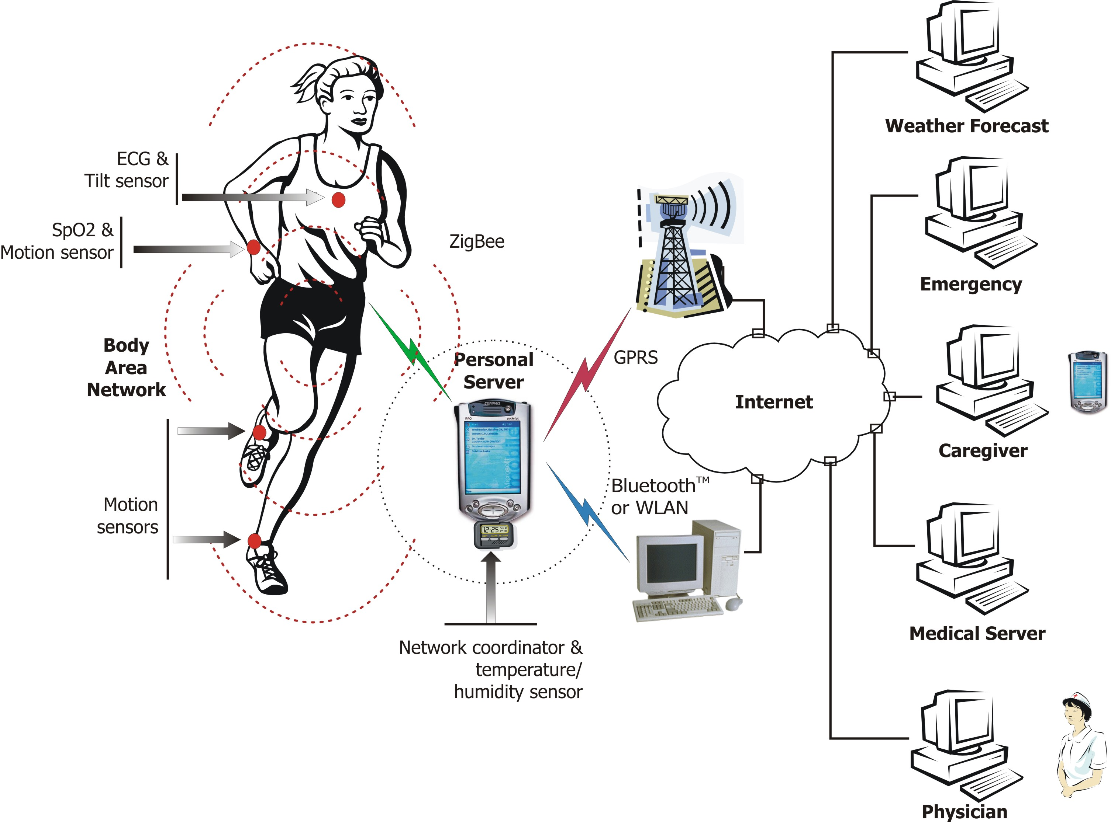
Ubiquitous Health Monitoring

Slide 4
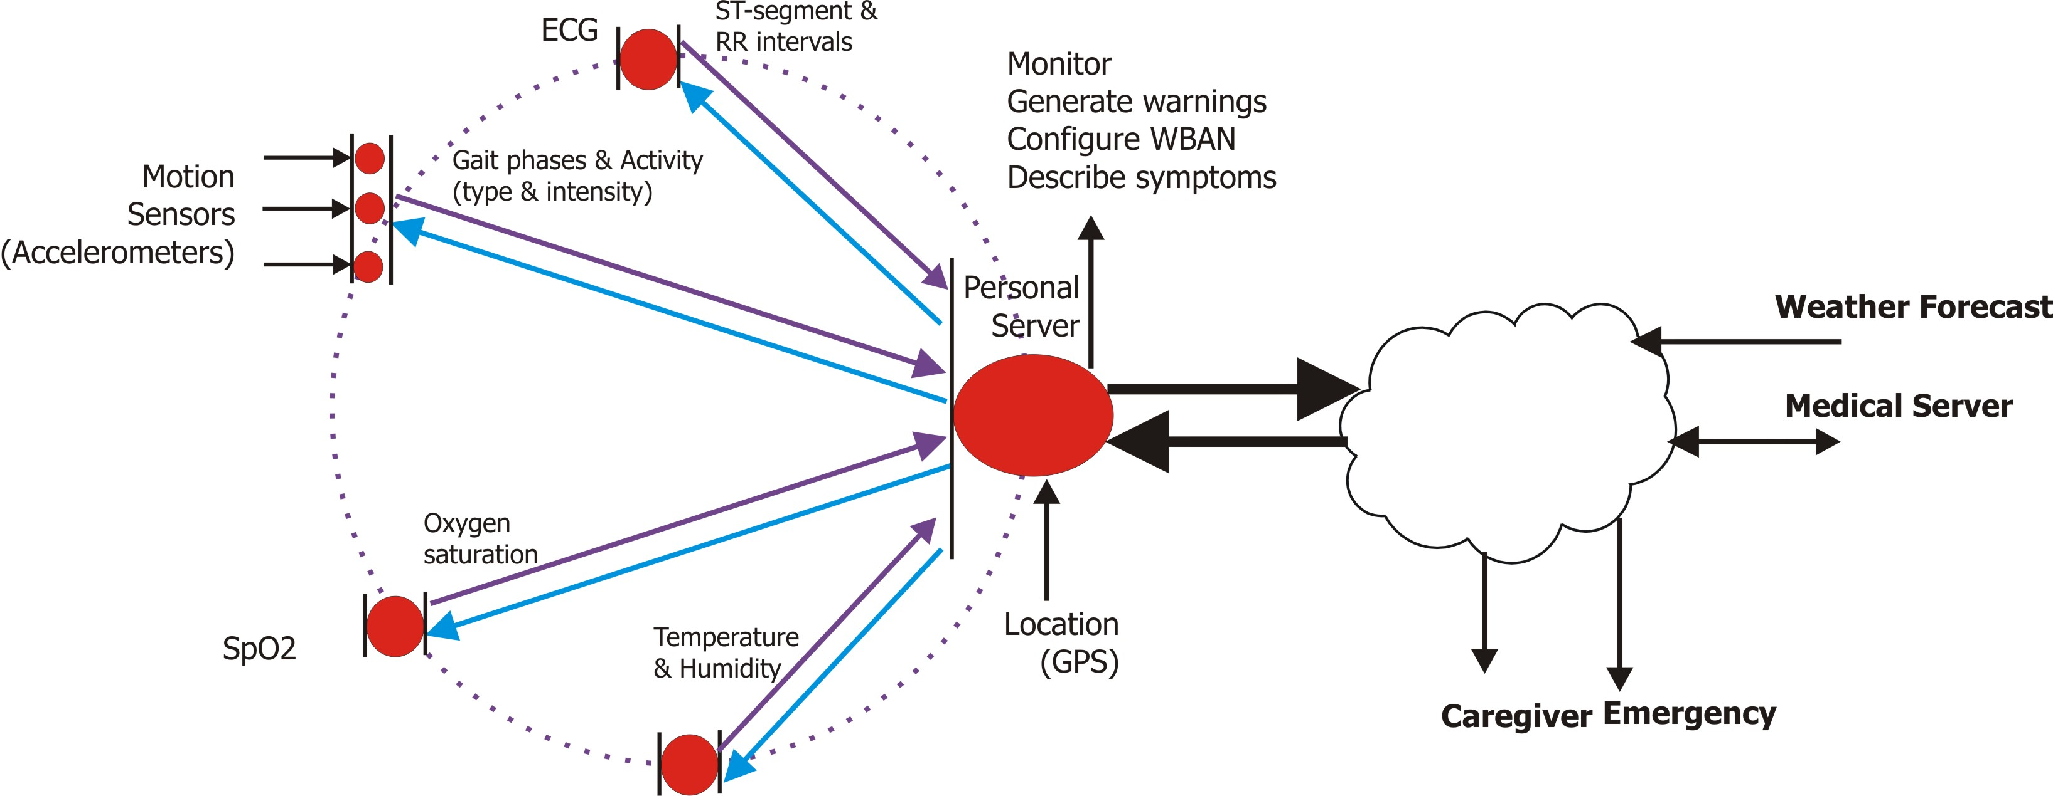
3-tier Hierarchical Organization
Tier 2: Personal Server
Tier 3: Medical Servers
Tier 1: WBAN

Slide 5
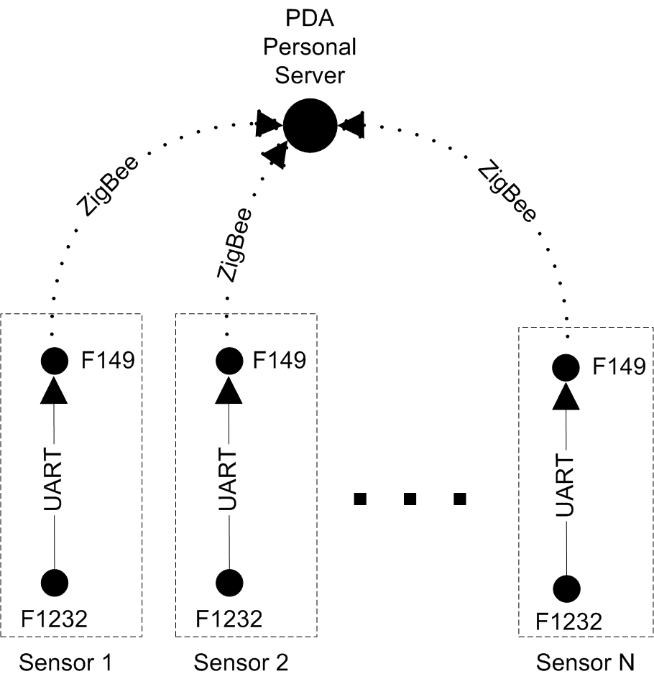
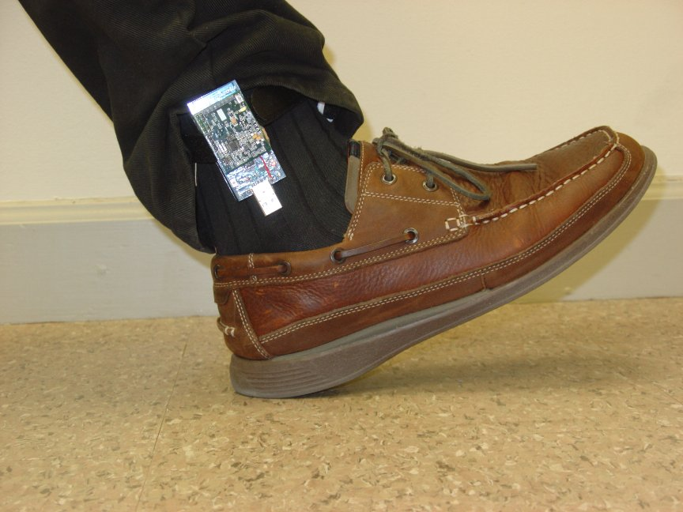
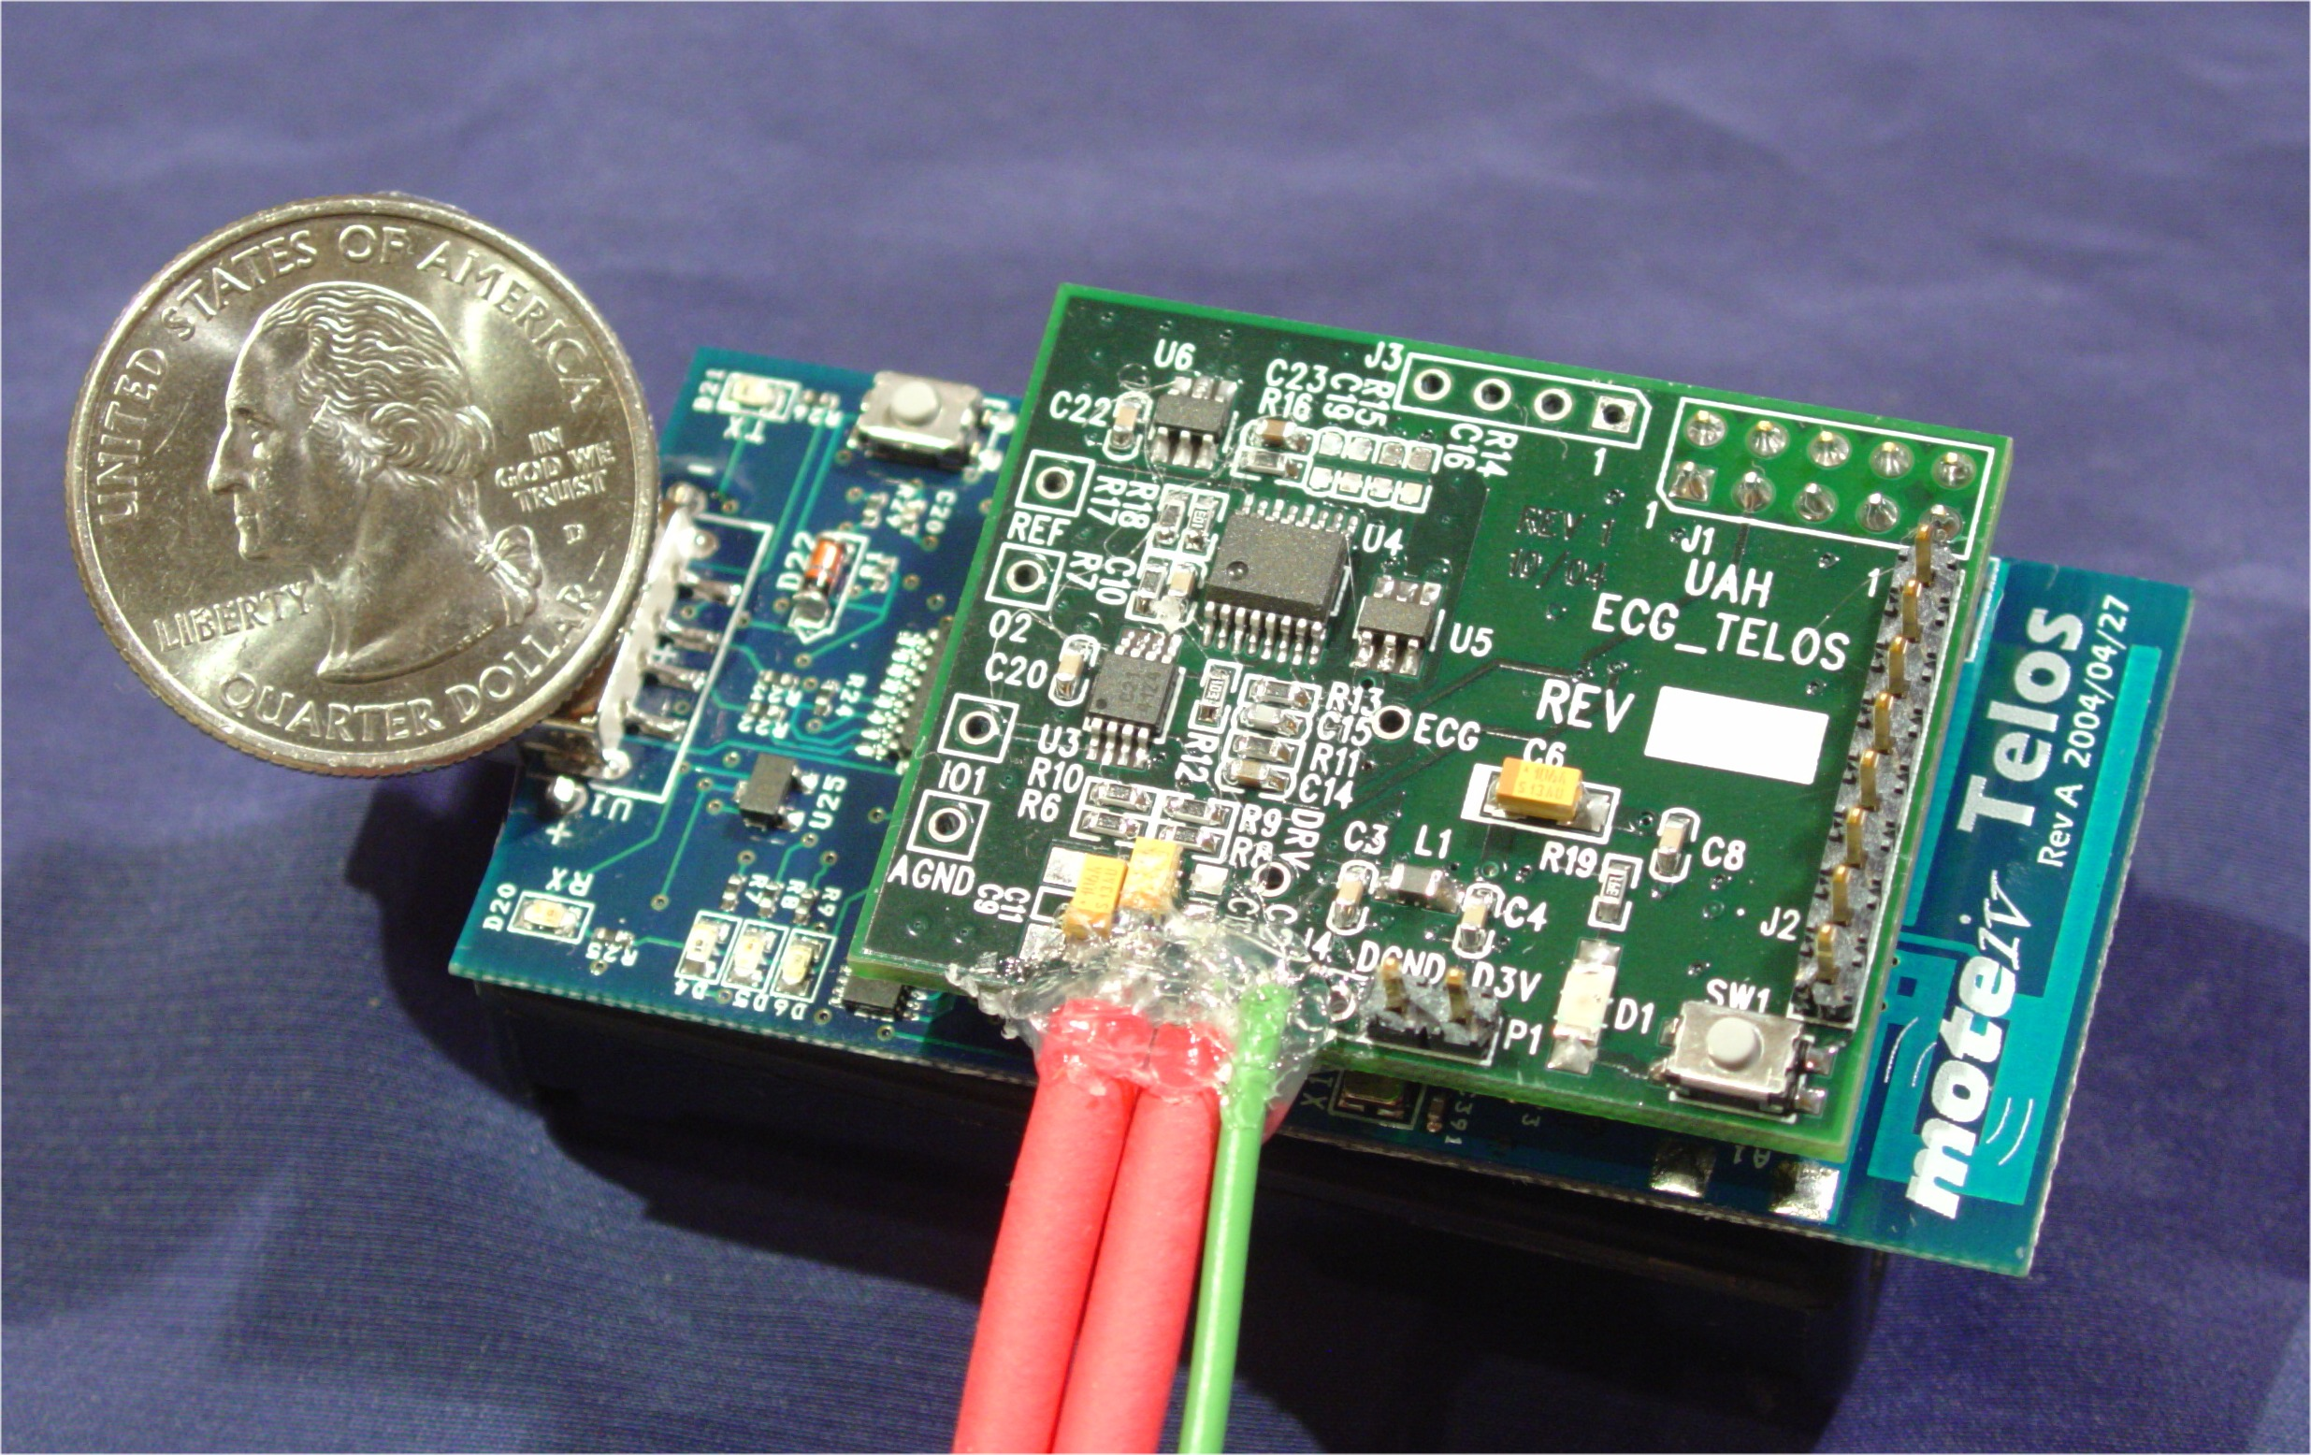
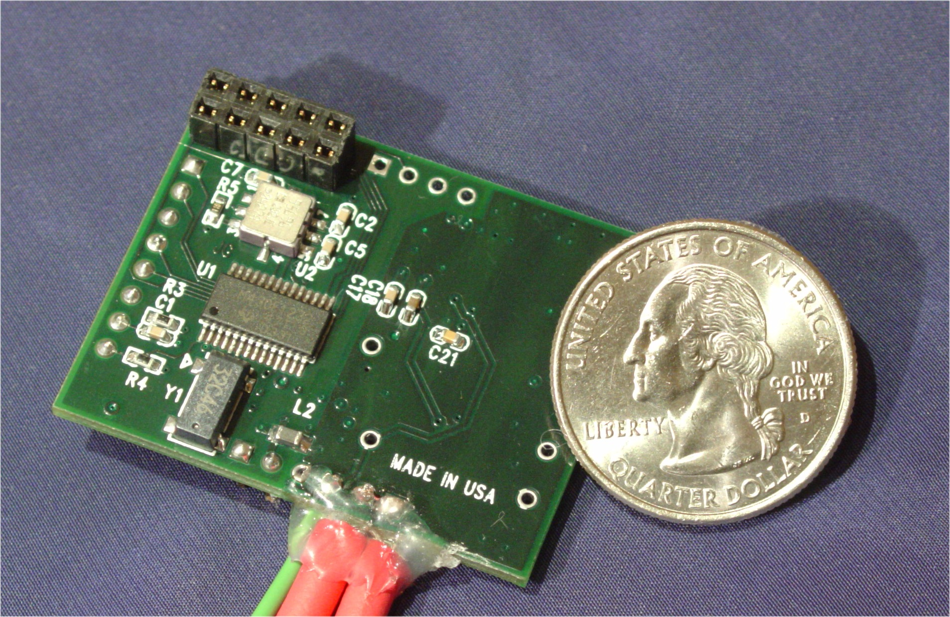
ActiS: Activity Sensor
ISPM
Telos
ADXL202
Accelerometer
TI
MSP430F1232
TI
MSP430F149
CC2420
(ZigBee)
ADXL202
Accelerometer
Flash
ECG Signal
Conditioning
USB Interface
ECG electrodes
Ax
g
θ
Ay
ActiS as
Motion Sensor

Slide 6
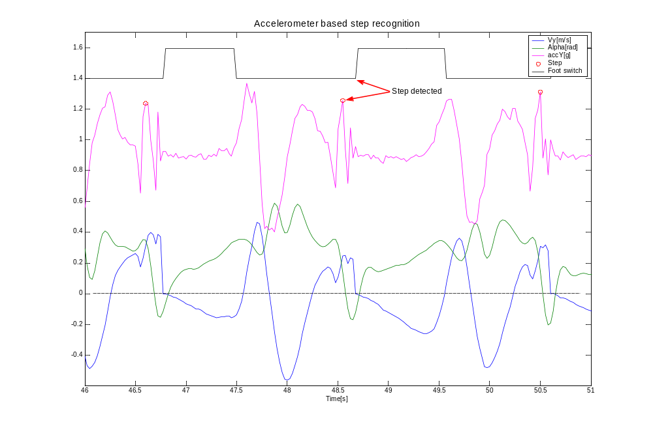
ActiS: Signal Processing

Slide 7
ActiS: Communication Timing
Cycle #9
Cycle #10
Cycle #1
Cycle #2
Cycle #3
...
Telos
ISPM
CC2420 Rx
CC2420 Tx
Start Radio
Transmit
Stop Radio
≈ 6 ms
3.5-8 ms
400 us
Start
Done
Transmit Done
Stop
Done
Problem: USART sharing!

Slide 8
Issues in WBAN
Affordable and ubiquitous monitoring
  Utilize common off-the-shelf components,
  capable of seamless integration into a WBAN
Open issues
  Standardization of sensors
  (specificity, range, precision, type)
  Rules of engagement and sensor placement
  Sensor calibration & customization
  Integration of data into medical databases
  Privacy and security
Social impact and business opportunities
Working group for Health-Monitoring Applications (Tiny-HMS)

Slide 9
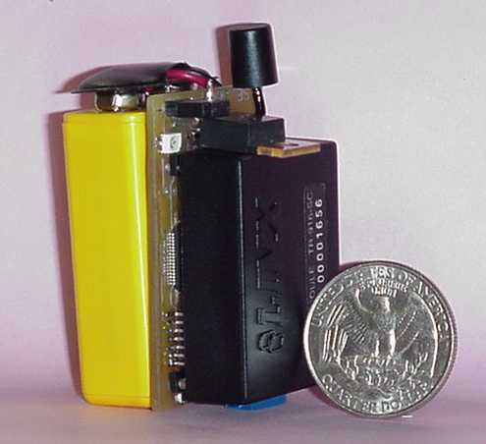
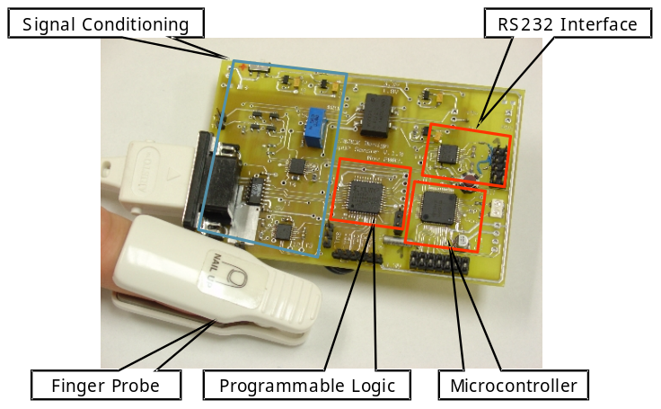

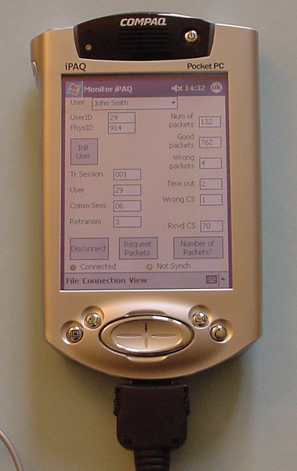
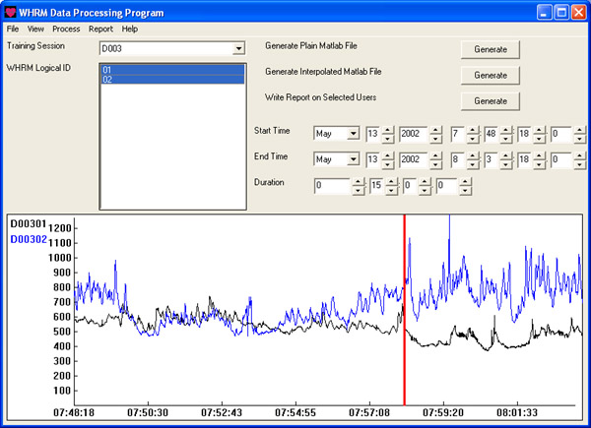
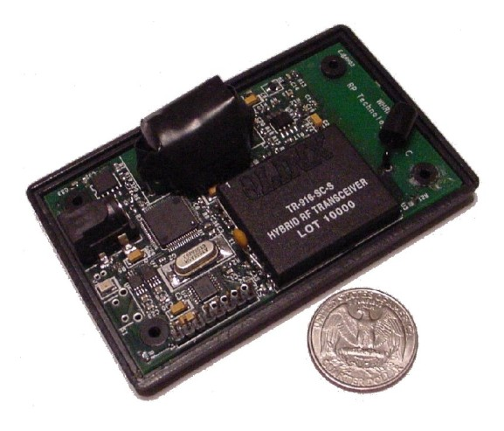
Historical Overview
Basic WISE (Y00)
Reconfigurable SpO2 Sensor (Y04)
WHRM
MOGUL
Distributed Stress Monitoring (Y03)

